Slide 1
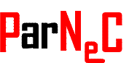

Trust Region-Guided Proximal Policy Optimization
Pattern Recognition & Neural Computing Group
http://parnec.nuaa.edu.cn/
Nanjing University of Aeronautics and Astronautics
Yuhui Wang , Hao He , Xiaoyang Tan , Yaozhong Gan
11/3/2019

Slide 2
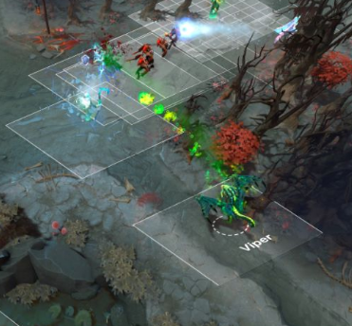

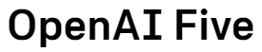
Reinforcement Learning Applications
More Sophisticated Stucture
More Complicated Models
More Computation Time:4500 year

Slide 3
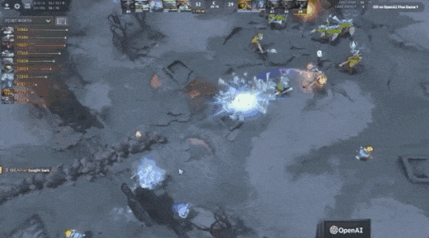
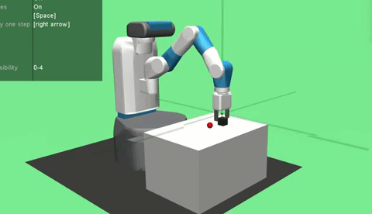

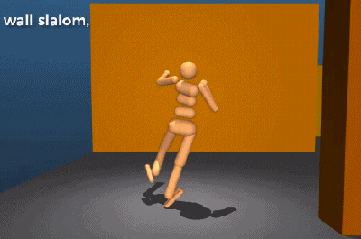
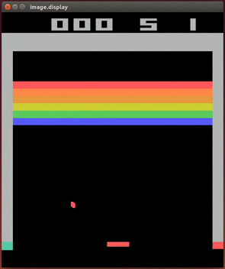
Why is PPO widely used?
It is easy to implement!
It is fast!
It has achieved great successes in a large number of tasks!

Slide 4
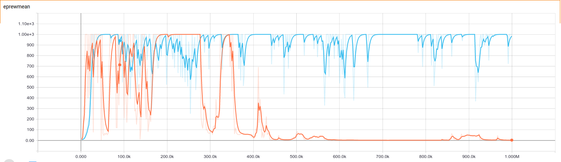

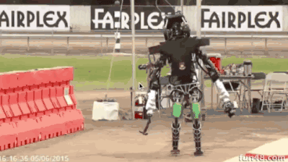
Drawbacks of Current RL Methods
Policy Degradation
Unstable

Slide 5
Agent Environment Interface

Slide 6
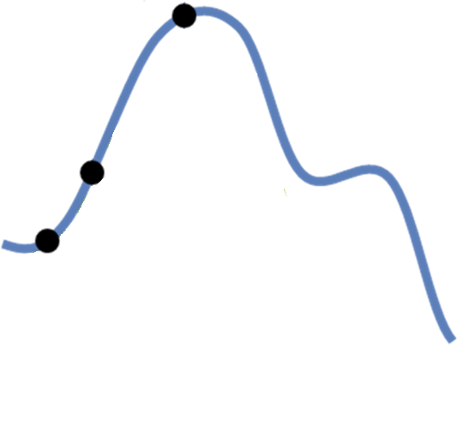
What cause the unstable issue?
The gap between the surrogate function and the objective function

Slide 7
What cause the unstable issue?
The inaccurate evaluation
Temporal Difference λ
Generalized Advantage Estimation
Actor Critic with Experience Replay
Notes:
这个有点类似于机器学习中的问题，如果我们在一堆数据上过度训练，有可能会导致过拟合。

Slide 8
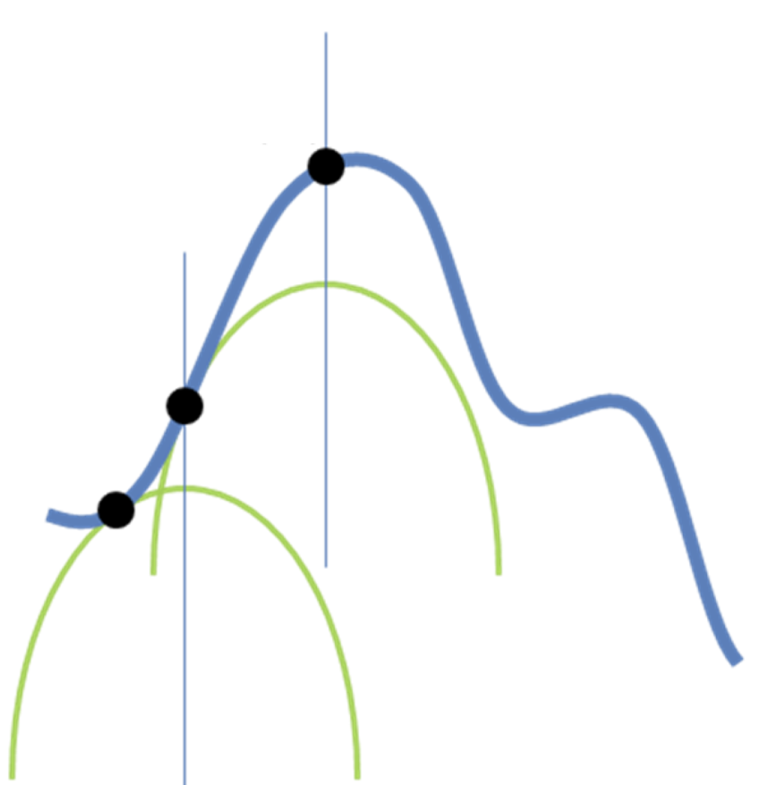
Trust Region Policy Optimization
Trust Region Constraint
Bring difficulty in optimization

Slide 9
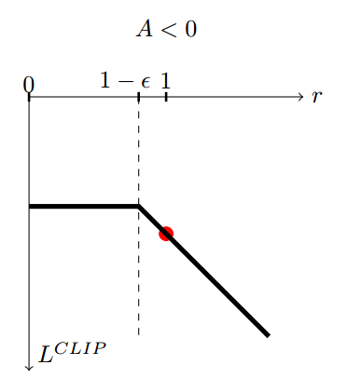
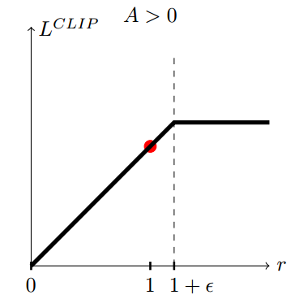
Proximal Policy Optimization

Slide 10
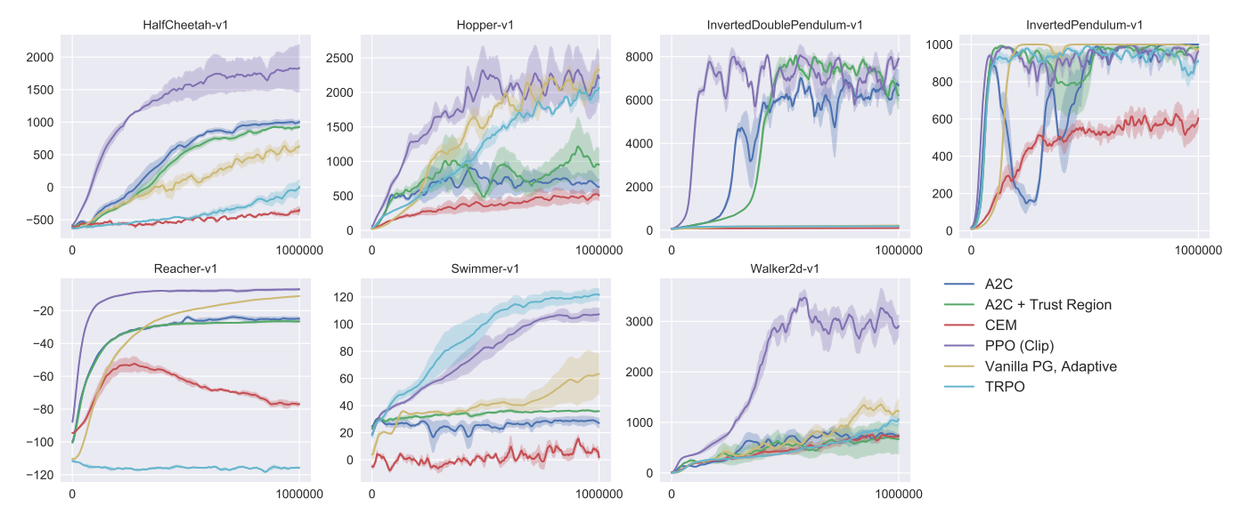
Experiment Result

Slide 11
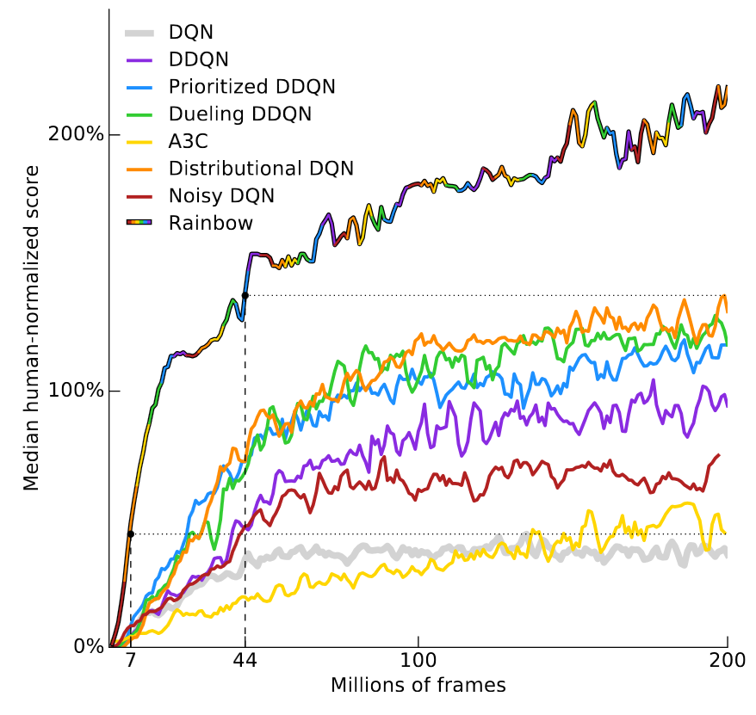
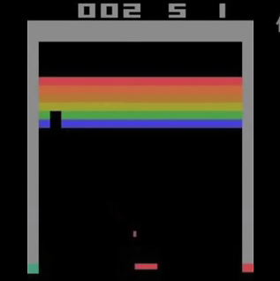


Drawbacks of Current RL Methods
√
Unstable
Sample Efficiency
Rainbow passes the 100% score of human
at about 18 million frames.
This corresponds to about 83 hours of play experience.
The policy constraint could aggravate this issue!

Slide 12


Challenges of Current RL Problem
Exploration: gather more information
Exploitation: make the best decision given current information
Unstable
Arm 1
Arm 2
Arm 3
Sample Efficiency
Reward:
20
0
?
Arm 1 (exploitation) or Arm 3 (exploration)?
Exploration

Slide 13
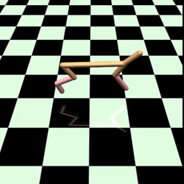
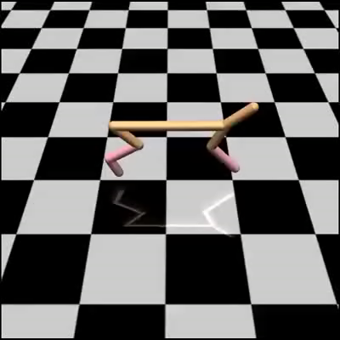
The lack of exploration problem of PPO

Slide 14
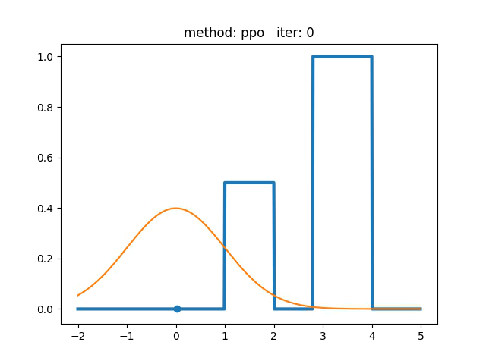

The lack of exploration problem of PPO
PPO
Vanilla Policy Gradient
Notes:
TODO: 右边改成vanilla

Slide 15
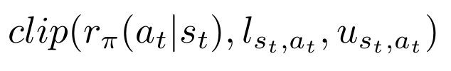
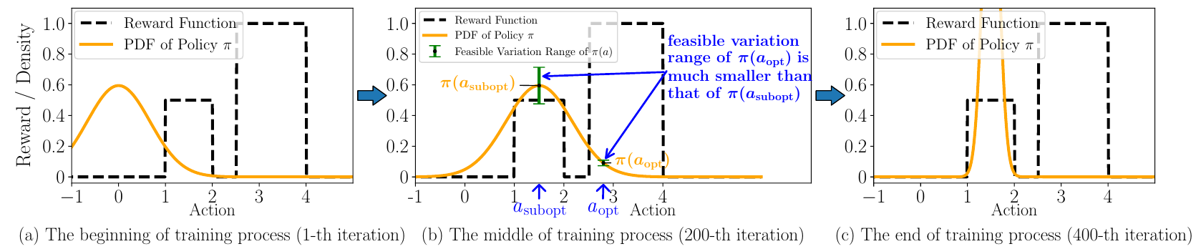
The issue of constant clipping
Feasible Variation Range
PPO:
Feasible Variation Range is linear with the preference to take the action!
The policy constraint could introduce extra bias on the exploration behavior of policy!
Easily get trapped into local optima!

Slide 16
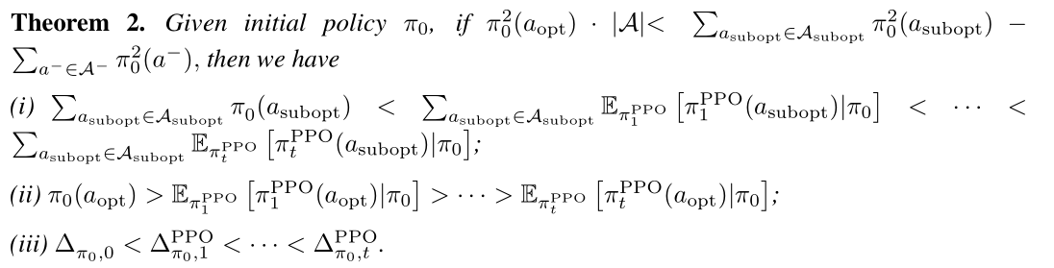
Theorem

Slide 17
How to solve the exploration problem
Naïve methods such as ϵ -greedy
Upper confidence bounds
Entropy Regularization
The additional regularization term may harm the stable learning

Slide 18
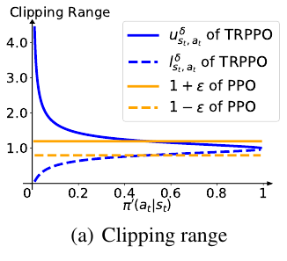
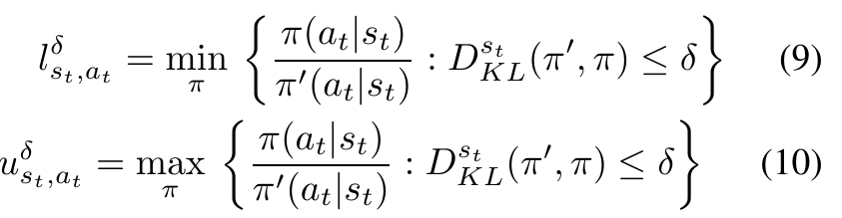
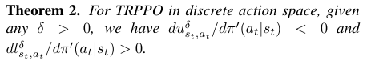
Our method
We focus on how to adaptively adjust the clipping range.
relax restrictions on behaviors which are less likely to be chosen: improve exploration and sample efficiency
do not harm the stability of PPO
The clipping range are enlarged as the choosing probability decreases
Notes:
我们的思路是直接从调整clipping range出发。
从之前的分析我们知道，如果放松对一些不太可能被选择动作的约束，是有可能解决这种exploration的问题的；
但是放松约束的同时，有可能也会对算法的稳定性产生影响。
但是从理论上来看，实际上真正影响稳定性的是KL距离，而不是概率比值。所以如果我们把clipping range设为trust region（也就是KL约束范围）内最优的值，理论上也不会损失它的性能。

Slide 19
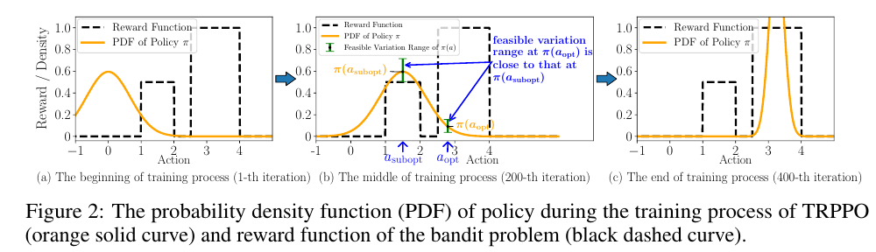
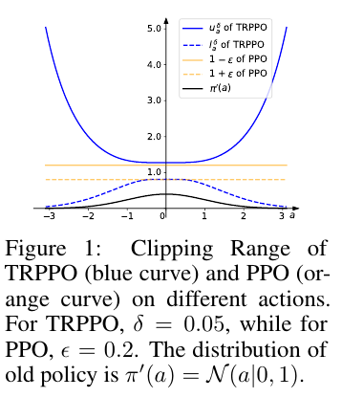
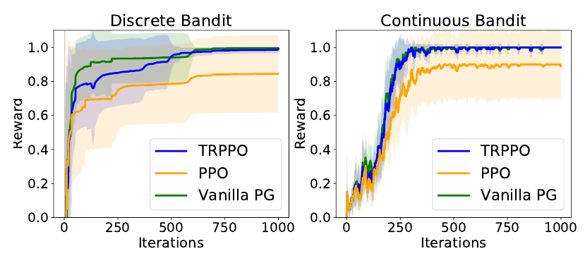
Behavior on the Bandit Problem

Slide 20
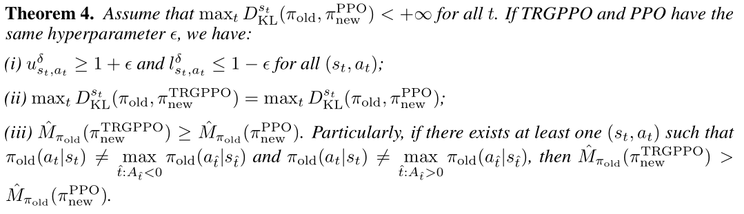
Theorem
Better performance lower bound

Slide 21
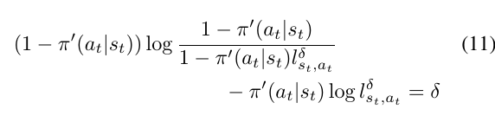
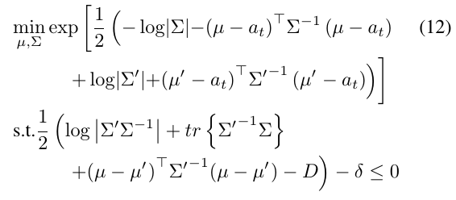
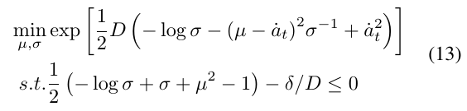
How to obtain the adaptive clipping range
Discrete Action Space:
Continuous Action Space:

Slide 22
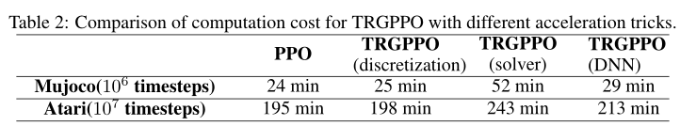
Computation cost

Slide 23
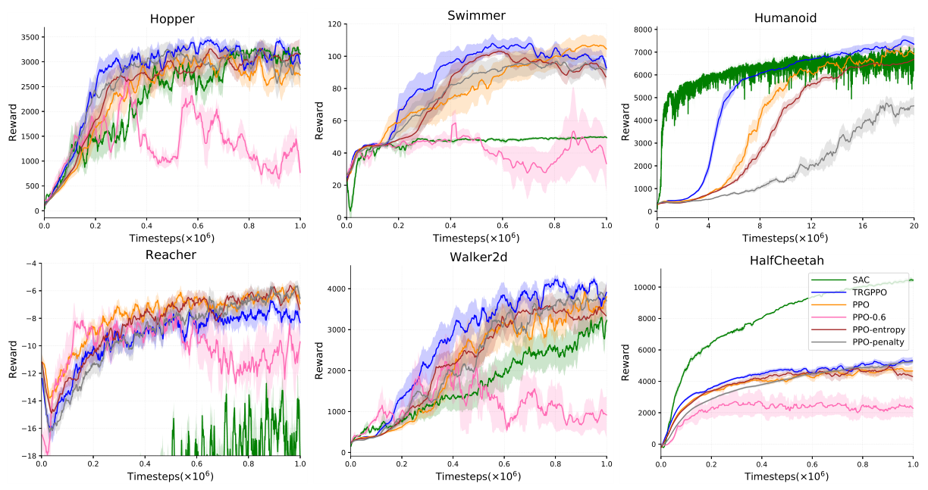
Experimental results

Slide 24
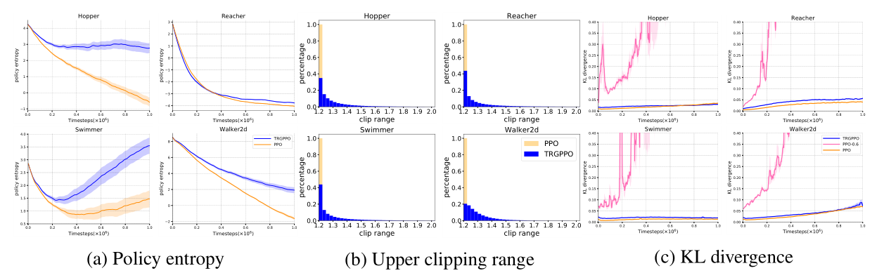
Property of Policy

Slide 25
Conclusion
Contributions
The lack of exploration issue of PPO.
TRPPO could improve exploration behavior and sample efficiency of PPO while not harm its stability
TRPPO achieves better empirical performance bound compared to PPO
Future work
A novel mechanism to introduce inductive bias to guide the policy behavior (adaptive clipping vs. Maximum entropy, curiosity-driven)
Different metric of policy learning may lead to different behavior of policy
The clipping function could not fundamentally restrict the policy within the trust region

Slide 26
Thank you!

